Slide 1
SoftWeb Technology Solutions
CREATING WEBS CONNECTING EVERYONE

Slide 2
ABOUT US
“Softweb Technology is Web & it Solutions Provider in Bangalore. We are mainly focused to offer superior, long-term and sustainable services to clients to fulfill their business intent.”
VISION
“To grow both vertically and horizontally to establish ourselves on top as a preferred Web & IT Solutions provider.”
MISSION
“To Achieve excellence in providing the best Web & IT solutions to customers to meet their present and future business needs in the most efficient and effective way.”

Slide 3
Today, website design & development is virtually indispensable to create a corporate brand identity of your company. It is crucial for any website design to be well-developed, attractive, user-friendly & informative for the customer. Web design plays a crucial role in distinguishing your products from that of your competitor's. It is also essential for your consumers to identify with your company Softweb Technology clients from across the world for whom we have developed customized solutions in not just various different fields of business, but also in their native languages/dialects to cater to their respective target audiences. This exposure has enabled us to enrich our knowledge about the workings of varied businesses globally, irrespective of the size of the enterprise. Our innovative & custom website designs help you project your company identity not just in the most effective manner, but also help you enhance your business with minimal effort in website management, that too at a very affordable price.

Slide 4
WEB DESIGN SERVICES
WEB APPLICATION DEVELOPMENT
E-COMMERCE & CMS INTEGRATION
24 X 7 TECH SUPPORT

Slide 5
Softweb Technology is a global End-to-End IT/ITES services and solutions provider. We help our customers to do business better with our industry wide experience, deep technology expertise and comprehensive portfolio of services. We believe in three important factors which are quality, value and time. Our clocks function to deliver you the best at the right time and at the right cost.
We provide end to end consulting and solutions to our clients. We will help to build a robust IT infrastructure that gives you a big advantage in modern market environment. Softweb Technology is a client oriented company. Our philosophy is to have the client at the focus point of all discussions and planning so that the product/service will be essentially client oriented. Our products will strictly adhere on our values quality, value and time. These policies make us one of the best software companies referred by our clients.
We are a team of qualified, well-trained professionals who are always up to the task. We are aggressive. We are competent. And we respect deadlines.

Slide 6
Softweb Technology is a software & Web development company based in India and we employ highly qualified engineers to provide the end to end software / Web solutions for the business or service sectors. The company was founded by a team of enthusiastic IT specialists who wanted to overcome the routine and create a company that would act in the market not only for business success but for the sake of Technology itself. Thus the mission of the company was defined - to contribute to forward –looking transformation of the society through software / Web development. Over five years of work, we have developed a range of solutions and gained ample experience in the services we offer: Custom Software Development and Web Development.

Slide 7
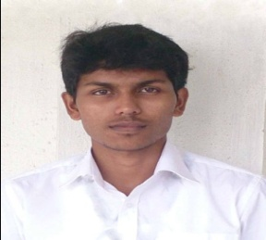
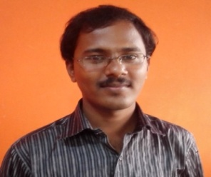
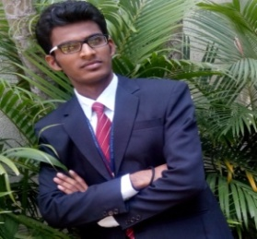
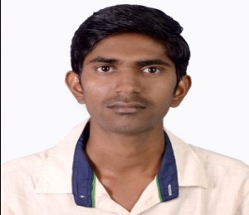
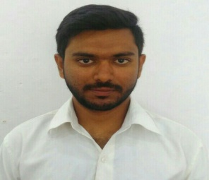
Abdul Saleem
IT MANAGER
Mathi Prakash E
NETWORK ADMINISTRATOR
Nagapriyan C
SENIOR WEB DESIGNER
Amrit Prajapat
.NET DEVELOPER
Raghuveeranagouda
PHP DEVELOPER
S.K.M. Riyaz
SALES MANAGER
Kavya Sanoj
JUNIOR WEB DESIGNER

Slide 8
SOFTWEB TECHNOLOGY SOLUTIONS

Slide 9
1
WEB DESIGNING
10
EMAIL MARKETING
2
SEO
11
HOSTING
3
SMO
11
GOOGLE PRODUCTS
4
LOGO DESIGNING
12
DOMAIN REGISTRATION
5
BULK SMS & VOICE SMS
13
PAYMENT GATEWAY
6
WHATSAPP MARKETING
14
API INTEGRATION
8
DYNAMIC WEBSITES
15
LIVE CHAT INTEGRATION
9
DATABASE PROVIDER

Slide 10
DEDICATED
SERVERS
DOMAIN
RESELLER
VPS
SERVERS
WINDOWS
HOSTING
CLOUD
SERVERS
HOSTING
LINUX
HOSTING
WINDOWS
HOSTING
RESELLER
LINUX
HOSTING
RESELLER

Slide 11
DYNAMIC WEBSITES THAT WE PROVIDES :
WORDPRESS
JOOMLA
CODE IGNATOR
DRUPAL
MAGENTO
SHOPIFY
PRESTASHOP
OPEN CART
MARKET PLACE
C CART
ZENCART
WOO COMMERCE
OS COMMERCE
PHP
ASP.NET
RUBY
ADMIN PANEL

Slide 12
NETWORK & SERVER
MAINTENANCE
APPLICATION DEVELOPMENT
SOFTWARE
DEVELOPMENT
WEB DEVELOPMENT
WEBSITE & APPLICATION
MAINTENANCE

Slide 13
IN APPLICATION DEVELOPMENT WE OFFER:
TRAVEL APPLICATION
E-COMMERCE
APPLICATION
REAL ESTATE
APPLICATION
CONTENT
MANAGEMENT
SYSTEM
ANDROID APPLICATION
JOB
PORTAL
EDUCATION
PORTAL
CLASSIFIED
DIRECTORY
DEVELOPMENT
TUTOR
APPLICATION
DEVELOPMENT
IPHONE
DEVELOPMENT
WIRE FRAME
WEB
DEVELOPMENT
SUGAR CRM
APPLICATION

Slide 14
IN SOFTWARE DEVELOPMENT WE OFFER:
ATTENDENCE
MANAGEMENT
JEWELLERY
TEXTILE
MANAGEMENT
BILLING
CUSTOMER
RELATIONSHIP
MANAGEMENT
SCHOOL
MANAGEMENT
HOTEL
MANAGEMENT
HR & PAYROLL MANAGEMENT
HOS PITAL
MANAGEMENT
NEWSPAPER BILLING
MOVIE TICKETING
ONLINE EXAM
ZOO TICKETING
PAYING GUEST

Slide 16
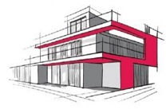

Slide 23
WE ARE ALWAYS READY TO HELP YOU
Softweb Technology Solutions,
#17/1, 1st floor, Star Complex,
Bhuvaneshwari Nagar,
Sultan Palya Main Road
R.T Nagar , Bangalore 560032
info@softwebtechnology.co.in
it@softwebtechnology.co.in softwebtechnologysolutions@gmail.com
080-2365 7786 , 080-42019046
99451 95712, 9845816192
www.softwebtechnology.co.in

